Slide 1
Motion Sensors
Seeing the unseen

Slide 2
Physical Security
If a physical device can be reached, this bypasses a lot of security measures
Password hashes can be broken without any alarms being tripped
Encryption only lasts for a certain length of time
Theft

Slide 3
Mitigating Factors
Door locks
Motion sensors
Cameras
Security guards

Slide 4
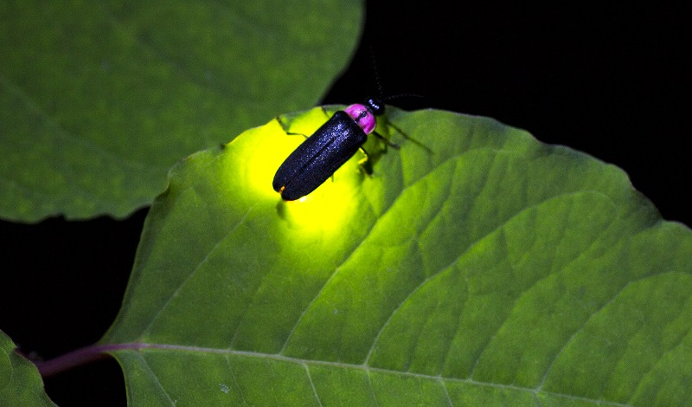
How do we see?
Animals that emit light are a lot more visible in the dark
Can you tell the direction of the sun with your eyes closed?

Slide 5
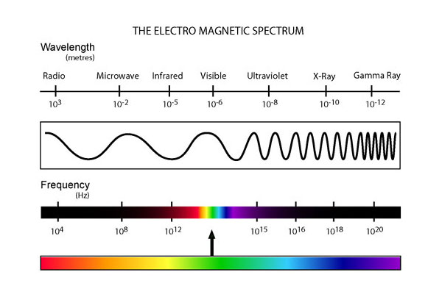
Infrared Light
Visible light makes up a small portion of possible wavelengths of light
Anything that is warm puts off infrared light

Slide 6
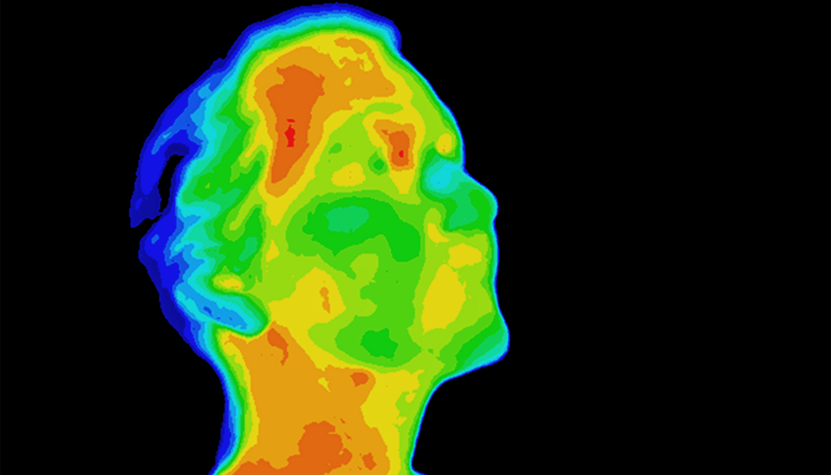
Glow-in-the-dark people
We do emit light, for those who care to look

Slide 7
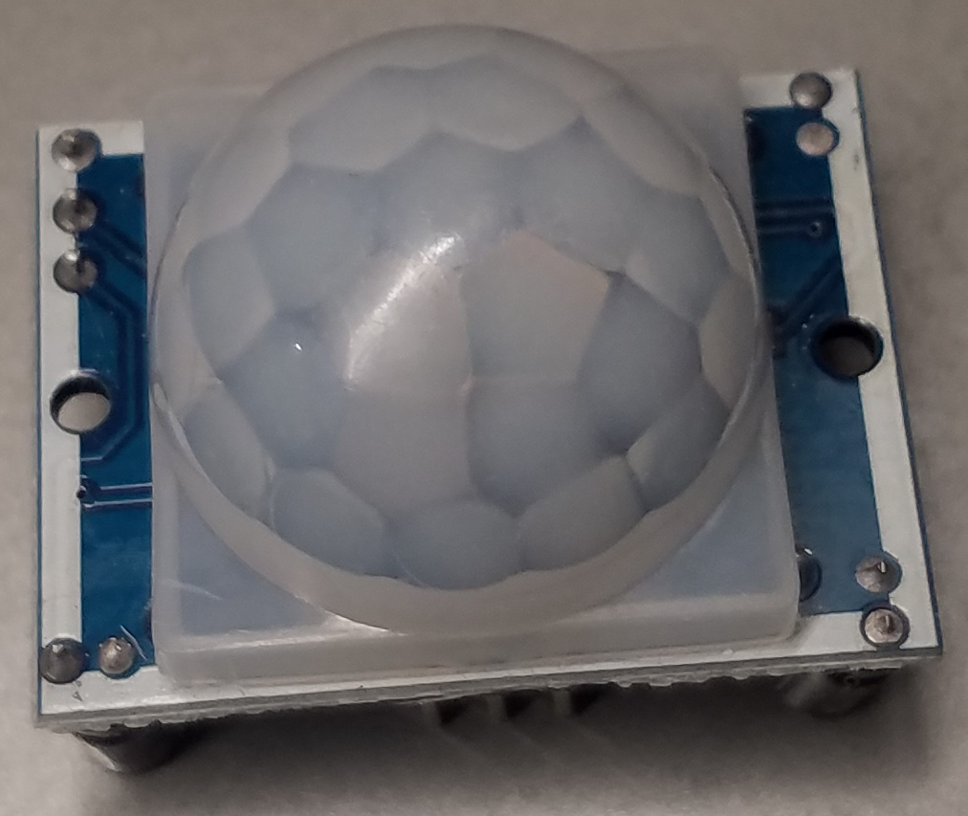
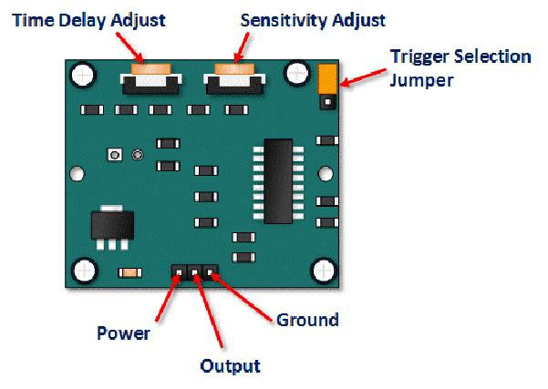
PIR Sensor

Slide 8
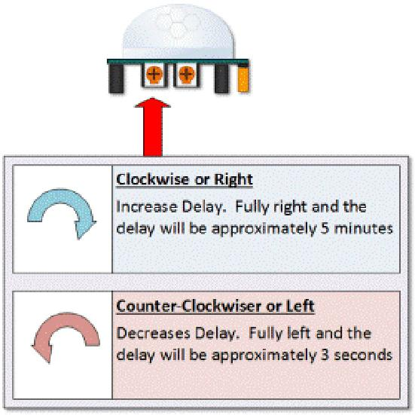
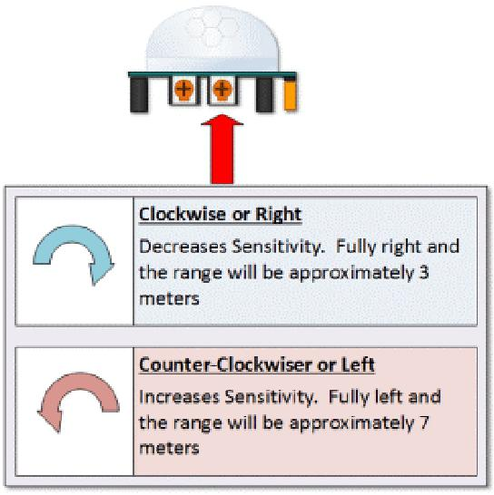
Making adjustments

Slide 9
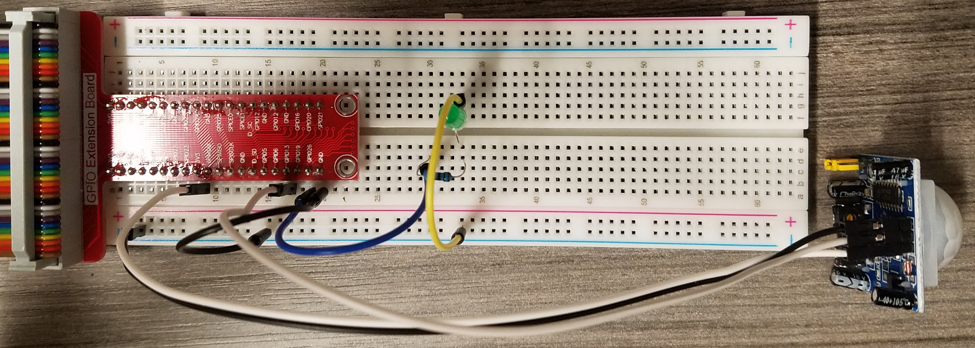
Sensor status
Connect sensor to GPIO 13
Connect LED to GPIO26
python3 motiondetect.py

Slide 10
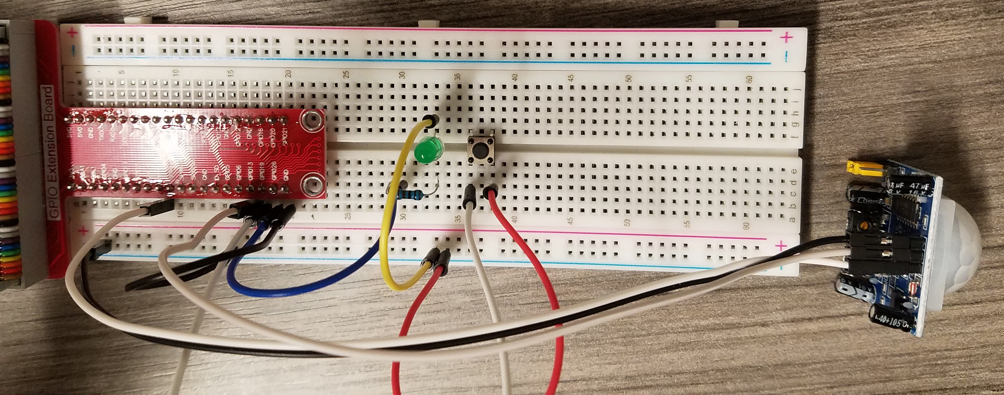
Adding a reset button
Sensor to GPIO 13
LED to GPIO26
Button to GPIO19
python3 maze.py

Slide 11
Cron
Periodic tasks can be run with cron
crontab -e
Scroll to the bottom and add:
@reboot /home/pi/project/2021_gencyber_summer_camp/resources/day5/maze.py
Reboot the pi with: sudo shutdown -r 0
The script will now run without connecting keyboard/mouse/monitor

Slide 12
Maze
5 teams defend while 1 attacks
Defending teams place sensors (max 1 per table).
Defending teams must retrieve 5 objects. False alarms earn other teams points
Attacking teams must retrieve 5 objects while triggering as few alarms as possible. Earn 5 points per item retrieved.
Correctly triggered alarms earn points

